Slide 1
National Federation of Women’s Institutes
Resolution Shortlist
November 2016
Alleviating loneliness
‘This meeting calls on every WI and the NFWI to work alongside health and social care providers and their local community to raise awareness of the causes and impacts of loneliness, thus ensuring better identification of lonely people in order to be able to offer them the appropriate assistance and support.’
Place image here
Place image here
Notes:
[Read out title and wording of the resolution]
The proposer of this resolution would like to see greater recognition of the impact of loneliness as a serious health issue and for WIs to work with primary, secondary and social care providers to actively identify people suffering with loneliness and to take appropriate action. She would like to see WIs working proactively to alleviate loneliness in their communities.

Slide 2
Outline of presentation
What is ‘loneliness’ and who does it affect?
What are the consequences of loneliness?
How can loneliness be tackled?
National responses to tackling loneliness
How the WI could work on this resolution
Arguments for, arguments against
Shutterstock.com
Notes:
This resolution addresses an issue which affects everyone and to which a huge number of people are exposed. To explain the topic fully, first I will explain what loneliness is and who it affects
Click
Then I will discuss some of the implications of being lonely Click
How loneliness can be tackled Click
I will go on to give a brief overview of what is happening at a national level to tackle loneliness Click
Then I’ll discuss how the WI could possibly work on this resolution if it were to pass Click
And then round off the discussion with some key arguments for and against the motion Click

Slide 3
What is loneliness
“… a mismatch between the quantity and quality of social relationships that we have, and those that we want.”
Shutterstock.com
Notes:
There is no set definition of loneliness, but it is generally described as a “mismatch between the quantity and quality of social relationships that we have, and those that we want.” Click
It’s an emotional, rather than physical, state. It is not the same as social isolation, although people who are socially isolated are at greater risk of loneliness.

Slide 4
Who does it affect
15%
15%
65-79 year olds
29%
Aged 80 and over
Working age people
Not just older people…
Notes:
Loneliness does not just affect older people;
As we can see from this graphic, 15% Click of working aged people Click ; a similar number of people Click aged 65-79 Click ; and 29% of people Click aged 80 and over Click experience loneliness.
And it can effect anyone; personal circumstances, such as bereavement, poor health, living alone, living away from family, a lack of transport, becoming a carer, or living on a low income can make someone more vulnerable to feelings of loneliness.
The potential to be exposed to these risk factors increases with age, and so older people are more likely to suffer from loneliness, and it has been found that belonging to a minority ethnic or social group can also make people more vulnerable to loneliness.
And in an era of council cuts, many of the support services which ensure people don’t fall into loneliness, such as Children Centre’s and bus services are closing or losing their funding.

Slide 5
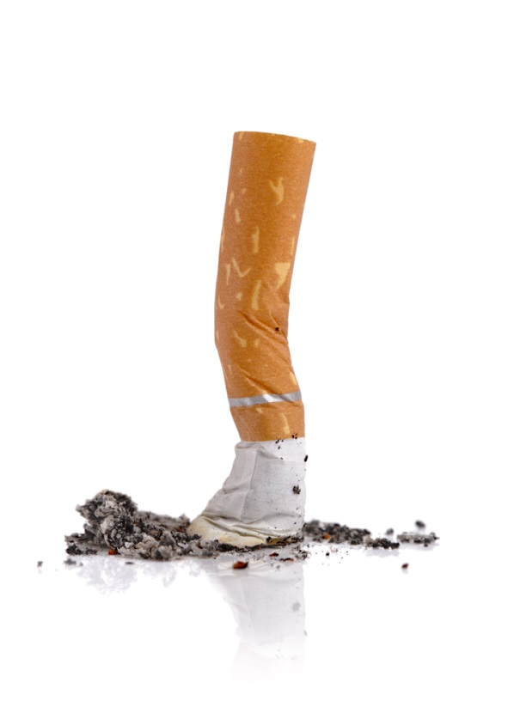
What are the consequences?
More likely to suffer from depression
Increased risk of high blood pressure
More likely to develop dementia
More damaging to health than physical inactivity or obesity
Health implications on a par with smoking 15 cigarettes a day
1.8 times more likely to visit their GP
1.6 times more likely to visit A & E
3.5 times more likely to enter local authority care
Shutterstock.com
Notes:
There are health and social implications for people who suffer from loneliness.
If you’re lonely you’re more likely to suffer from depression click ,
have an increased risk of high blood pressure click are more likely to develop dementia click,
Loneliness is more damaging to health than physical inactivity or obesity click,
And health implications on a par with smoking 15 cigarettes a day click,
This leads to pressures on social services – older people who are lonely are, on average 1.8 times more likely to visit their GP click,
1.6 times more likely to visit A&E click
and 3.5 times more likely to enter local authority residential care click.
So tackling loneliness therefore makes sense, not just from a social and ethical perspective, but also from an economic perspective
The Local Government Association maintains that implementing measures to combat loneliness don’t need to be financially burdensome, particularly if existing resources are better targeted.
In fact, a scheme in Gloucestershire to identify the most lonely and isolated in the community resulted in savings of £1.2million to health and social care services, with every £1 invested in the scheme seeing a return in investment of £3.10.

Slide 6
How can loneliness be tackled?
Local authorities
Community groups
Health and social care providers
Requires input from a wide range of partners…
Notes:
Combating loneliness requires input from a wide range of partners, including local authorities, click health and social care providers, click and community groups click.
Raising awareness and removing the stigma that is attached to being lonely is an important first step in ensuring that people who are lonely, but may not recognise the fact (or feel reluctant to admit it) start accessing the help and services that they need.
Local authorities use a range of techniques and work with a variety of local agencies to reach out to people who are lonely and encourage them to use services offered.
These include mapping against common risk factors to proactively target people who may need more social support, as well as using mass-media, mail-outs and leaflets to promote their activities.
Forging local partnerships and harnessing volunteers within the community is another key way to identify lonely people. For example hospitals or social workers might refer an at-risk individual to a charities’ befriending service, or the same charity might link in with community groups to promote their service and try to extend their reach to people who haven’t yet been identified.

Slide 7
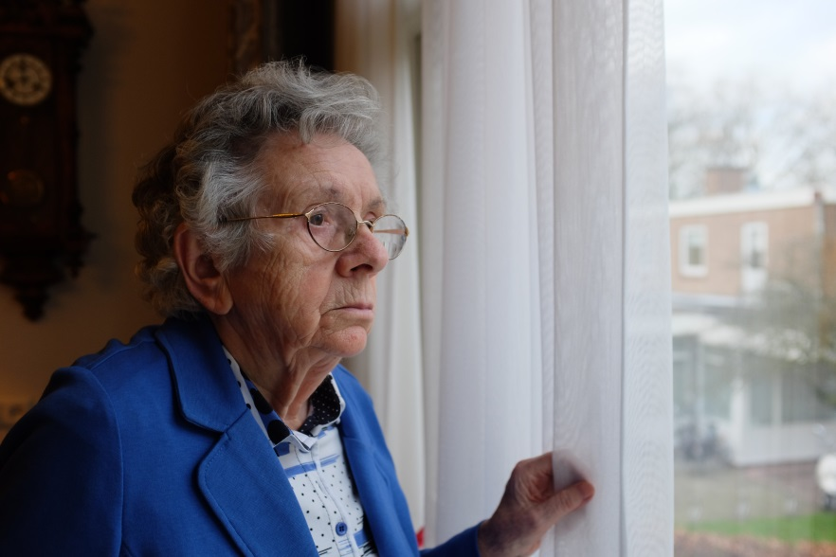
National responses to tackling loneliness
Local, rather than national
Health and wellbeing strategies in England – a mandatory requirement?
Welsh Government’s Strategy for Older People in Wales 2013-2023
Overall, interventions tend to focus on older people
Shutterstock.com
Notes:
Strategies to combat loneliness tend to focus on local, rather than national, action. click
Some have called on the government to incorporate loneliness as a mandatory requirement for local health and wellbeing strategies – at present this is voluntary. click
The Welsh Government’s Strategy for Older People in Wales 2013-2023 recognises the importance of social wellbeing for older people, click however research from the RVS shows that re-ablement services still tend to focus on improving physical wellbeing, to the detriment of those that address emotional and social wellbeing.
Overall, current UK and Welsh Government interventions tend to focus on older people. click

Slide 8
How the WI could work on this resolution
At a national level, work with partners to shine a spotlight on the issue.
Call on the UK government to ensure that loneliness is explicitly acknowledged in local health strategies.
In Wales, call on the government to encourage Local Health Boards to embed loneliness into their plans as part of its prudent healthcare drive.
At a local and regional level, WIs and Federations would be in a good position to use their networks to work in partnership with local partners to help identify people who are lonely, or at risk of loneliness.
Identify areas where people may be especially vulnerable, and organise dedicated activities to reach out to these people.
Notes:
At a national level, the NFWI could work with partners to shine a spotlight on the issue. click
The WI could call on the UK government to ensure that loneliness is explicitly acknowledged in local health strategies. click
In Wales, the NFWI could call on the government to encourage Local Health Boards to embed loneliness into their plans as part of its prudent healthcare drive, recognising that tackling loneliness is good for the future of the NHS as well as for people. click
At a local and regional level, WIs and Federations would be in a good position to use their networks to work in partnership with their local authority, health and social care providers, and local charities to help identify people who are lonely, or at risk of loneliness. Click
They could also help identify areas where people may be especially vulnerable, and organise dedicated activities to reach out to these people. click

Slide 9
Arguments for the resolution
This is a current and timely issue and, with an increasingly ageing population, is likely to become more acute. Despite this, there are relatively few organisations working on the issue nationally, and those who are tend to represent it through the lens of older people.
With this resolution, the WI has the opportunity use its influence and network to help catalyse a movement to bring awareness, understanding and action to a widespread problem.
Notes:
[read the text on the slide, clicking through each bullet point]

Slide 10
Arguments against the resolution
Could this resolution be seen as inviting WIs and WI members to impose themselves on other people, in situations where that attention may be unwelcome?
Is this resolution more a local, rather than a national issue? Could WIs work on this issue without the need to invoke a national resolution, and won’t many WIs be doing some of this work already?
Would this resolution reinforce stereotypes about the WI as focusing on older people?
Notes:
[read the text on the slide, clicking through each bullet point]

Slide 11
Further information
NFWI Public Affairs Department
E: pa@nfwi.org.uk T: 020 7371 9300
https://www.thewi.org.uk/campaigns
Age UK: www.ageuk.org.uk/
Campaign to End Loneliness: http://www.campaigntoendloneliness.org/

